Slide 1
Cyclistic Membership Analysis
Created by: Francis Bajamunde
File created on: 10/6/2023 12:34:06 AM

Slide 2
Introduction and Background
How do annual members and casual members use Cyclistic bikes differently?
Data used was from Cyclistic’s datasets.
Timeline of the data was during winter months (December - March) from 2020 to 2023.
Data from 2020 to 2023 was joined together to create one large dataset to perform an analysis on.
R was used to perform the analysis and create statistics
Tableau was used for visualizations
No entries were removed in order to keep an accurate account of the number of riders for both members and casual riders.

Slide 3
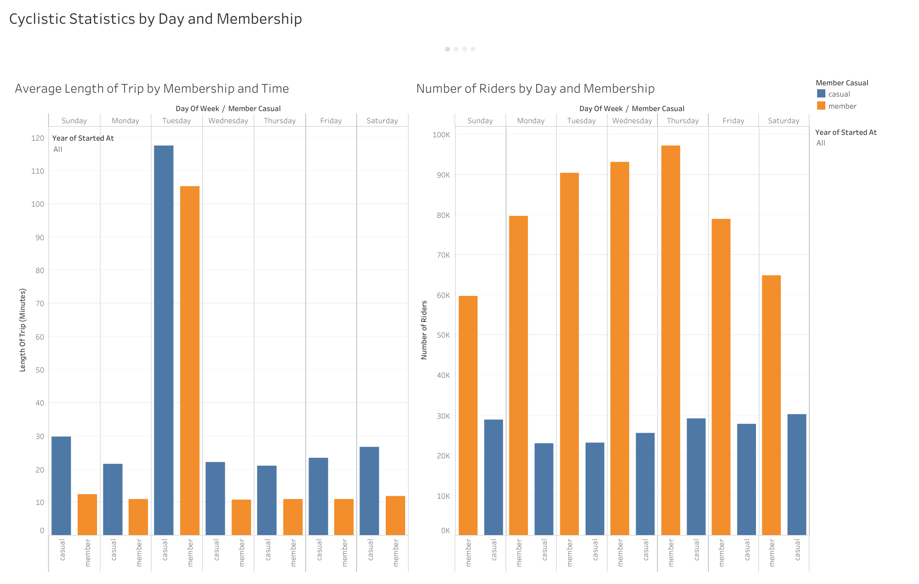
Notes:
Out of all of the years from 2020 to 2023, during the winter months, casual members have the longest average length for trips in comparison to members, while members make up the largest number of riderships by day.
Both Casual Riders and Members have the longest average trip on Tuesdays.

Slide 4
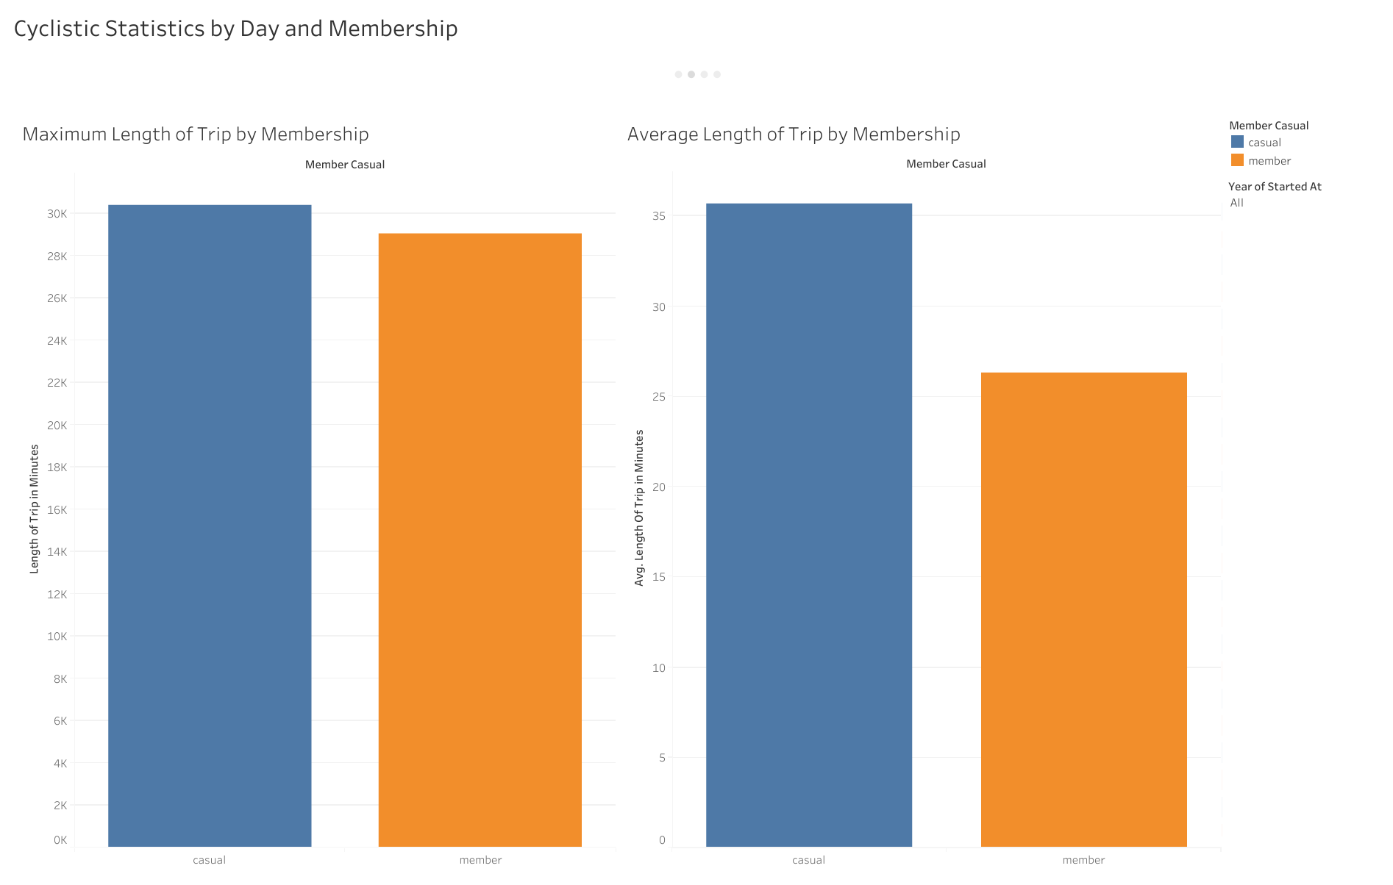
Notes:
Surprisingly, in both the statistics for the maximum length of trip and in the average length of all trips between membership types, casual riders, not members, have the longest average length of trips at around 35 minutes in comparison to members whose average trip time is 28 minutes.
Interestingly, the longest length of a trip was by a casual rider who clocked in at around 30,000 minutes.

Slide 5
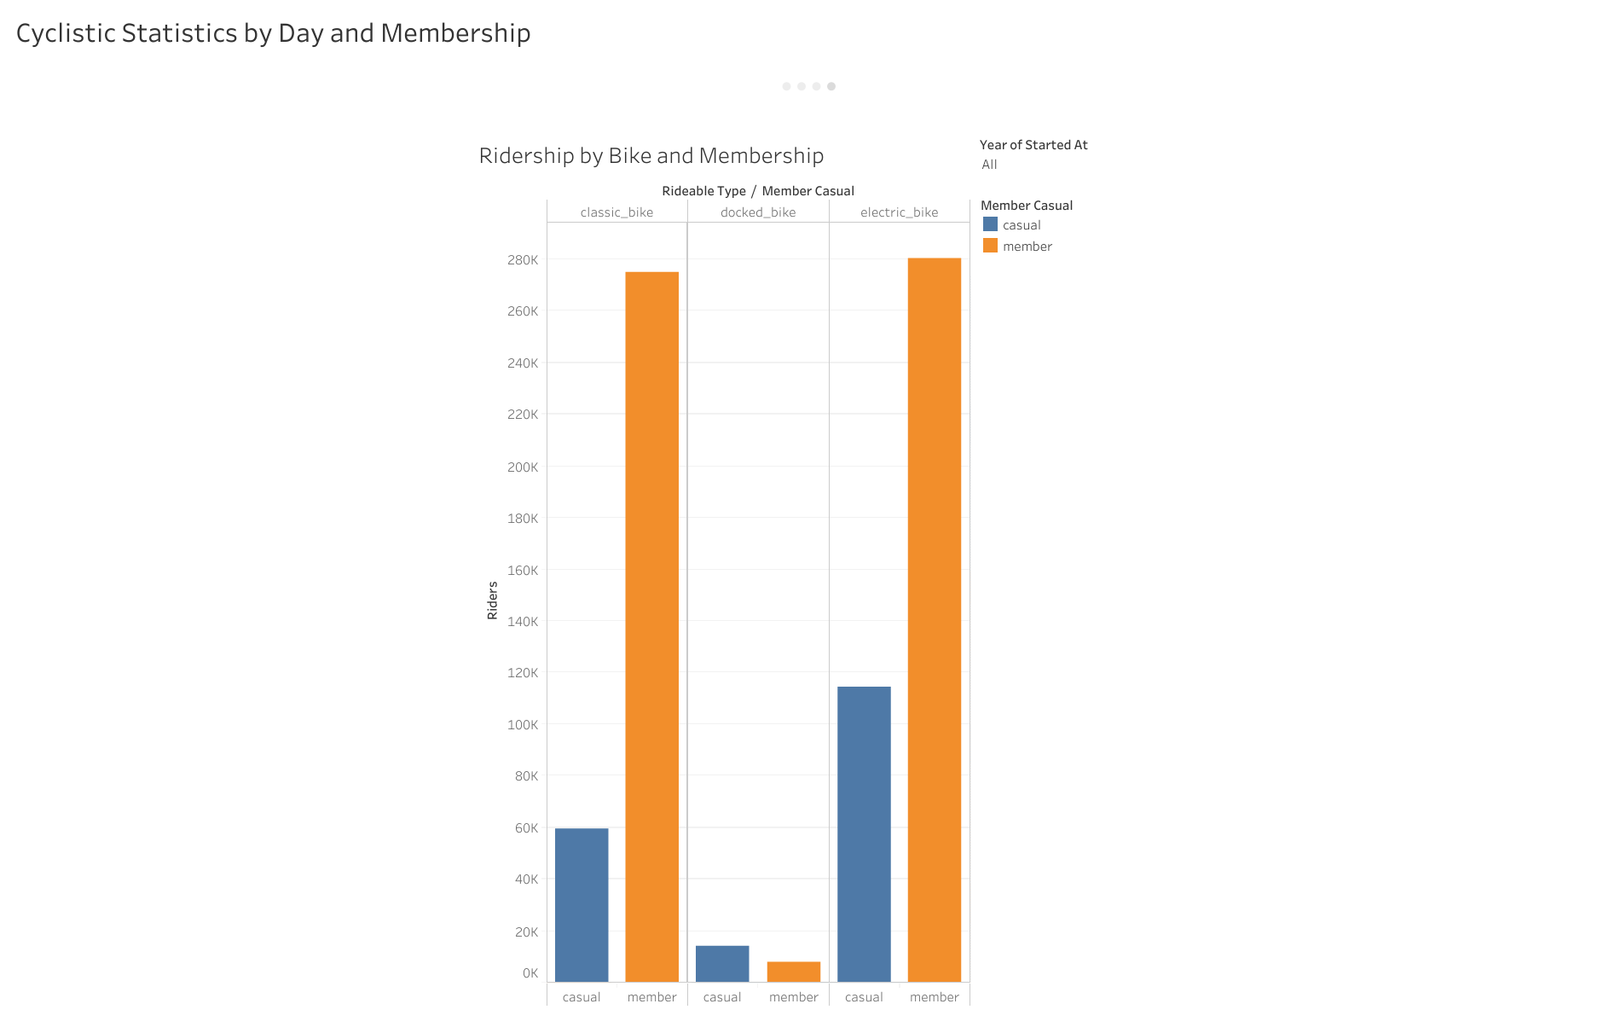
Notes:
Members overwhelmingly use electric and classic bikes, casual riders also follow this trend, however, they are more likely to use docked-bikes in comparison to their member counterparts.

Slide 6
Summary of Findings
Casual Riders have the longest average trip overall, clocking in at around 35 minutes.
Tuesdays have the longest trip times for both Members and Casual Riders.
Day-by-day analysis has Members outnumbering Casual Riders,
The largest amount of riders occur on Thursdays for both Members and Casuals.
Both Casual riders and Members overwhelmingly prefer the Classic and Electric Bikes
Casual riders do slightly prefer the docked bikes over their member counterparts.

Slide 7
Recommendations
Further study needs to be performed to determine why Tuesdays have the longest average travel times for both Casual riders and Members.
Since Casual riders have a stronger preference for Classic and Electric bikes, a possible marketing strategy can involve incentivizing membership by promoting Cyclistic’s line of Classic and Electric bikes.
In comparison to Casual riders, Members have lower average trip times. Further investigation can be performed on this to find the underlying reason why.
If Cyclistic’s membership program improves average trip time, perhaps Cyclistic’s marketing strategies can use that to further incentivize membership

